Slide 1
What is Academic Research and Where Does It Come From?
Database v Internet
Notes:
Copyright © 2009-2013 Independent Living Centre NSW. https://www.ilcnsw.asn.au/home/what_we_do/research.html

Slide 2
Warm Up
Notes:
Click on the graphic to link to Kahoot’s sign in page. Students will complete a 6 question quiz. Quiz is titled Internet or Database. If you have an account, you can duplicate the quiz and use it.

Slide 3
Where does the information come from? 1st, look at the ‘Information Cycle’
An Event Occurs
Scholarly Journals
Magazines
Provides Scholarly Research and Analysis about the subject, evidence to claims, & facts
Weeks
Months
Minutes-Hours
Days
Years
Web, TV, Radio
Newspapers
Books, Encyclopedias, Dictionaries
Notes:
Lib.uci.eduALA 2009 – An event occurs. Within minutes/hours, it is reported on the web/tv/radio. Within days, it is reported in newspapers. It takes a week or more for the event to be reported in magazines. Then, usually within several months, it could be included in articles found in scholarly journals. It takes YEARS for the event details to appear in books/encyclopedias/dictionaries.

Slide 4
Databases are NOT the Internet.
Sometimes, access to specific databases is restricted
access provided as part of college tuition
access available with a library card
https://www.youtube.com/watch?v=Q2GMtIuaNzU
(2:34)
Notes:
Good video overview of the topic

Slide 5
Now I’m convinced. I want to use a database to find information for academic research.
OPTIONS:
Maricopa County Library District
(Must have a library card)
http://mcldaz.org/ >
Click on Research (horizontal tool bar) > eSources for category listing
A-Z List for all databases >
Arizona State Library & Archives
FREE
http://www.azlibrary.gov/
Click on Digital AZ Library >
OR
Click on Resources for Learners>
High School & Junior High>
CGC Students
(must have student ID)
www.cgc.edu/library >
Click on eResources > “Reference” >
If you have been admitted to a college, you may already have access to their database.
http://library.lib.asu.edu/search/y
http://www.library.arizona.edu/search/articles/index.php
https://library.nau.edu/articles/bysubject
Notes:
Delete the options that might not be available to your specific students

Slide 6
Step 1: Brainstorm Keywords
http://youtu.be/Ui-iFnS-9hs
(1:28)
https://www.youtube.com/watch?v=x9diL8-ZpAk
(2:24)
Notes:
Short videos – plan one or both

Slide 7
Let’s Practice
Search Topic: influence of food advertising on childhood obesity.
Research question:
What is the impact of food advertising on childhood obesity?
KEY WORDS to start with
Food
Advertising
Childhood
Obesity

Slide 8
Keyword Search Web
snacks
fast food
food
Advertising/ childhood obesity
advertising
childhood
obesity
overweight

Slide 9
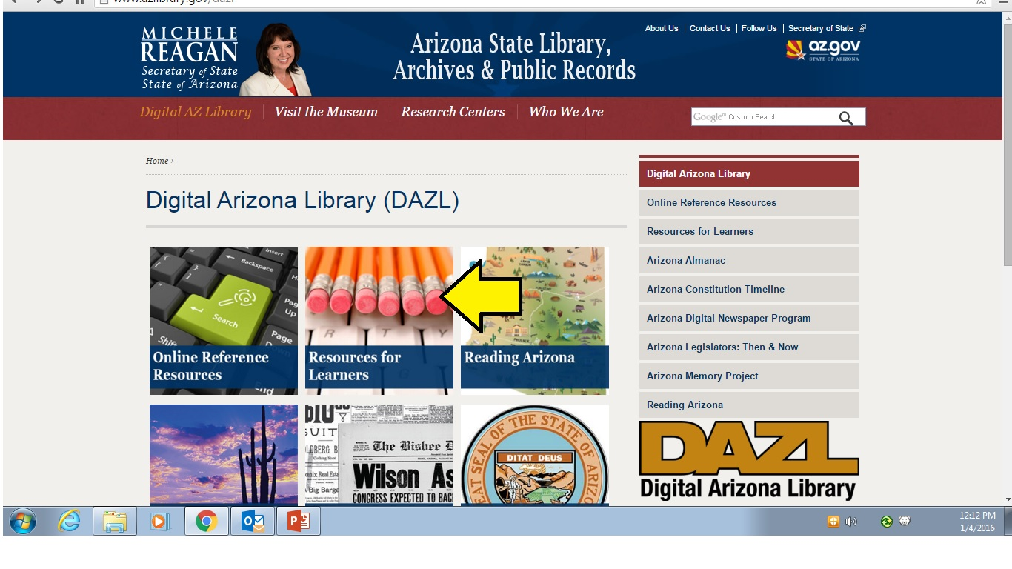
How to get to the databases
(let’s start with the FREE one)
Click Here

Slide 10
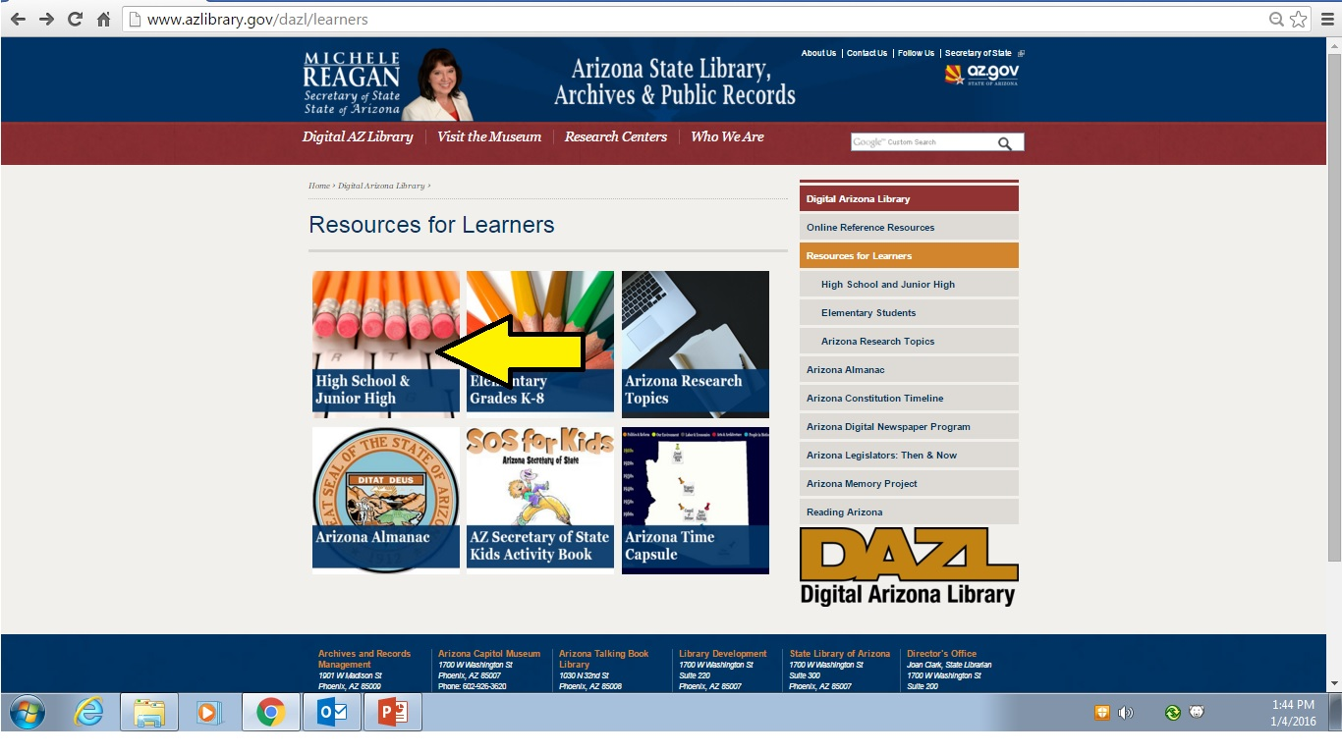
Click Here

Slide 11
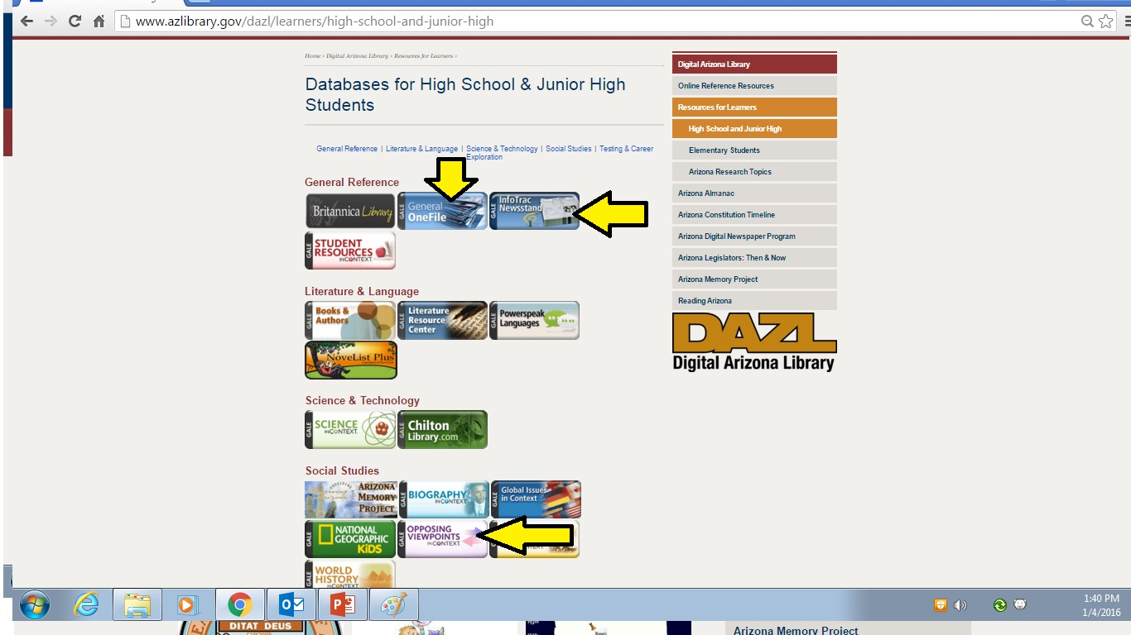
AZ State Library
CATEGORIES
These are the most helpful databases

Slide 12
Maricopa County Library eResources
CATEGORIES

Slide 13
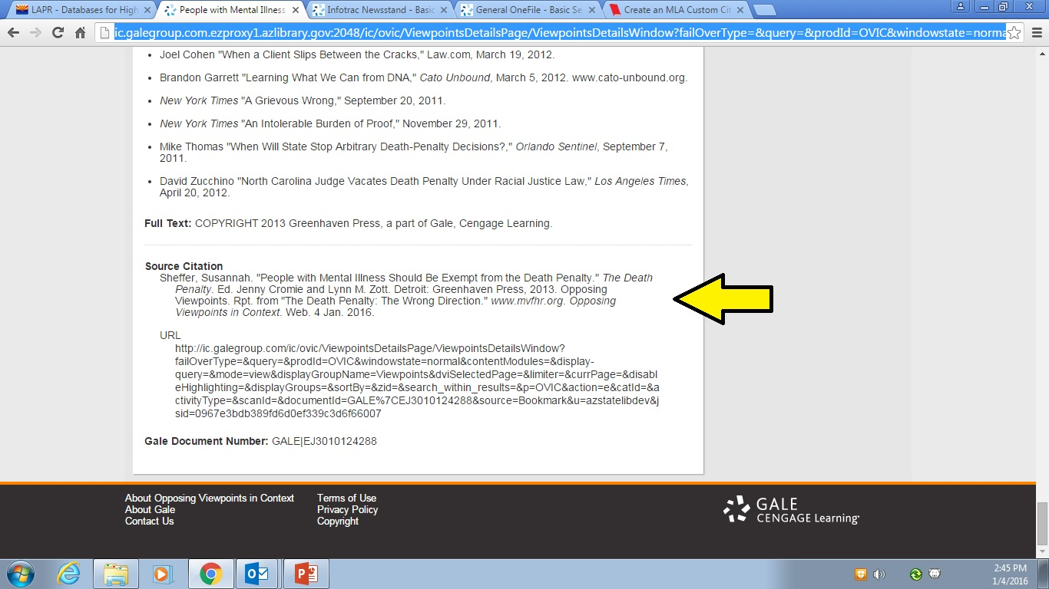
Biggest Benefit of Databases: Easy to Cite!
Step 3: Cite Your Sources
Databases have their own unique format.
At the end of EACH article, there should be a correctly formatted citation. You can copy and paste this into your Works Cited.
AZ State
Archives
End of the article

Slide 14
Important: you want to retain the formatting of the citation, especially the text that has to be italicized
Copy/Paste Clue for citations
Step 1: Select the text you want to copy

Slide 15
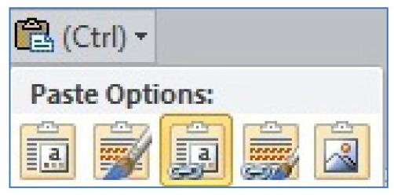
Copy/Paste Clue for citations
Step 2: Right click
Step 3: PASTE OPTIONS
Step 4: Select this one to RETAIN FORMATTING

Slide 16
Practice!
Explore & Evaluate Databases
Once you have selected your research topic:
Keyword Search
Database Research Practice

Slide 17
Before you leave….
How confident are you that you can access and use these databases for research in the future?

